Slide 1
Cryptocurrency
Visualizations
John Steskal, Prasanna Vanguri, Danielle Garcia

Slide 2
Objective
Team’s Key Requirements
Fastest growing cryptocurrencies over a certain time period
Majority of cryptocurrencies being purchased and sold: U.S.
Collected from past 4 years
Variety of cryptocurrencies

Slide 3
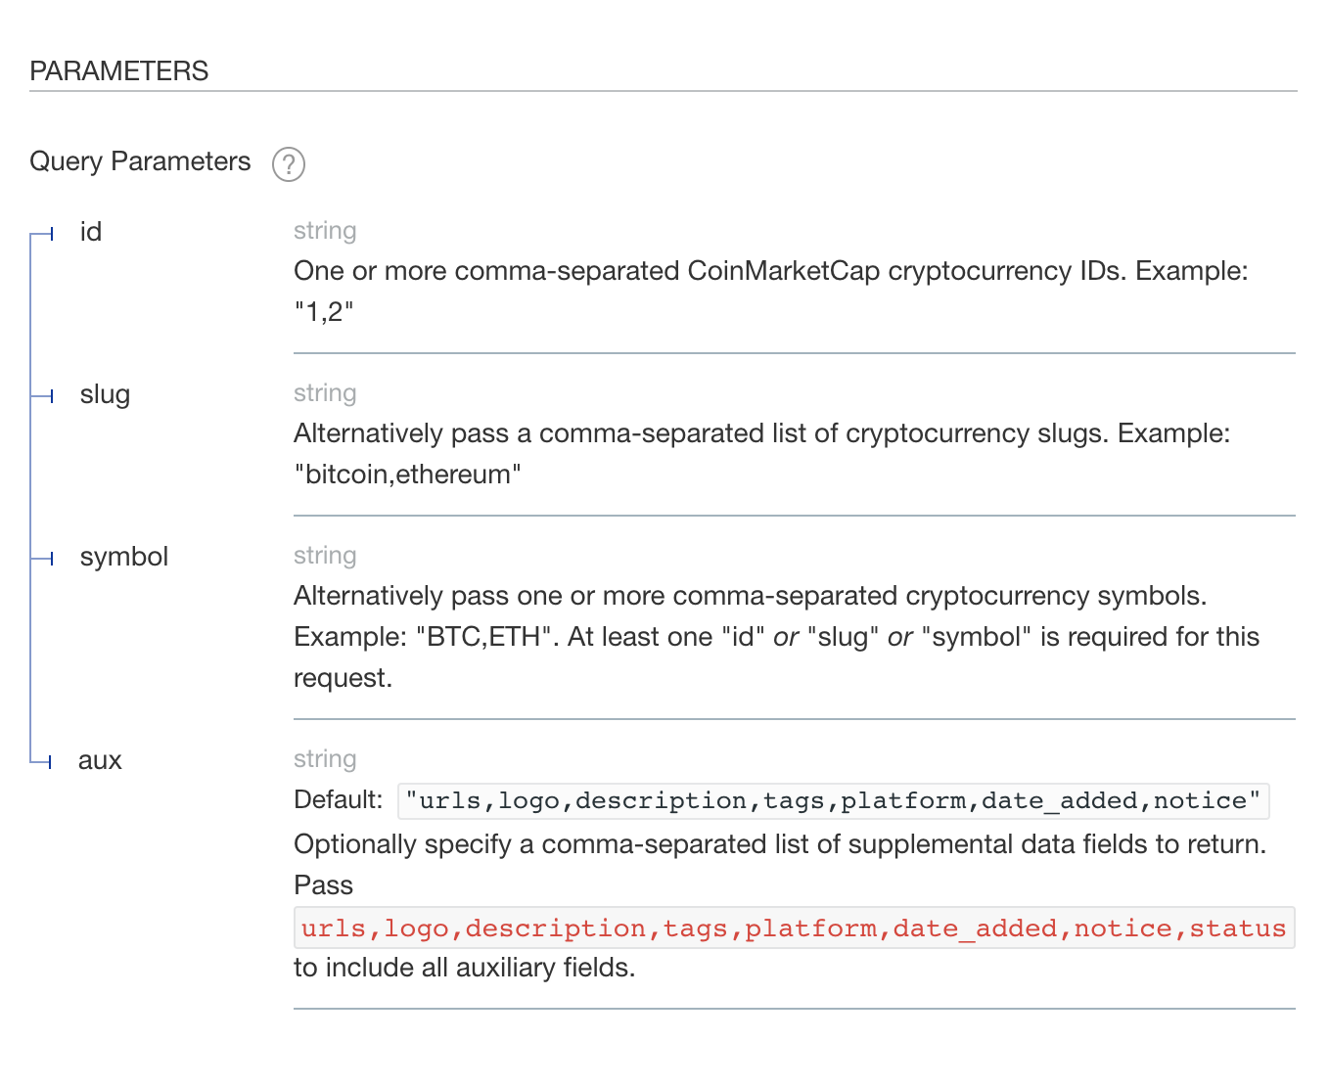
Data Collection
Coin Market Cap API: https://coinmarketcap.com/api/documentation/v1/

Slide 4
Technologies
01
Python | Jupyter Notebook | Javascript | HTML/CSS
02
Database | SQLite
03
Web Server | Flask
04
Javascript Libraries | Plotly | SQL-Wasm | SQL.js

Slide 5
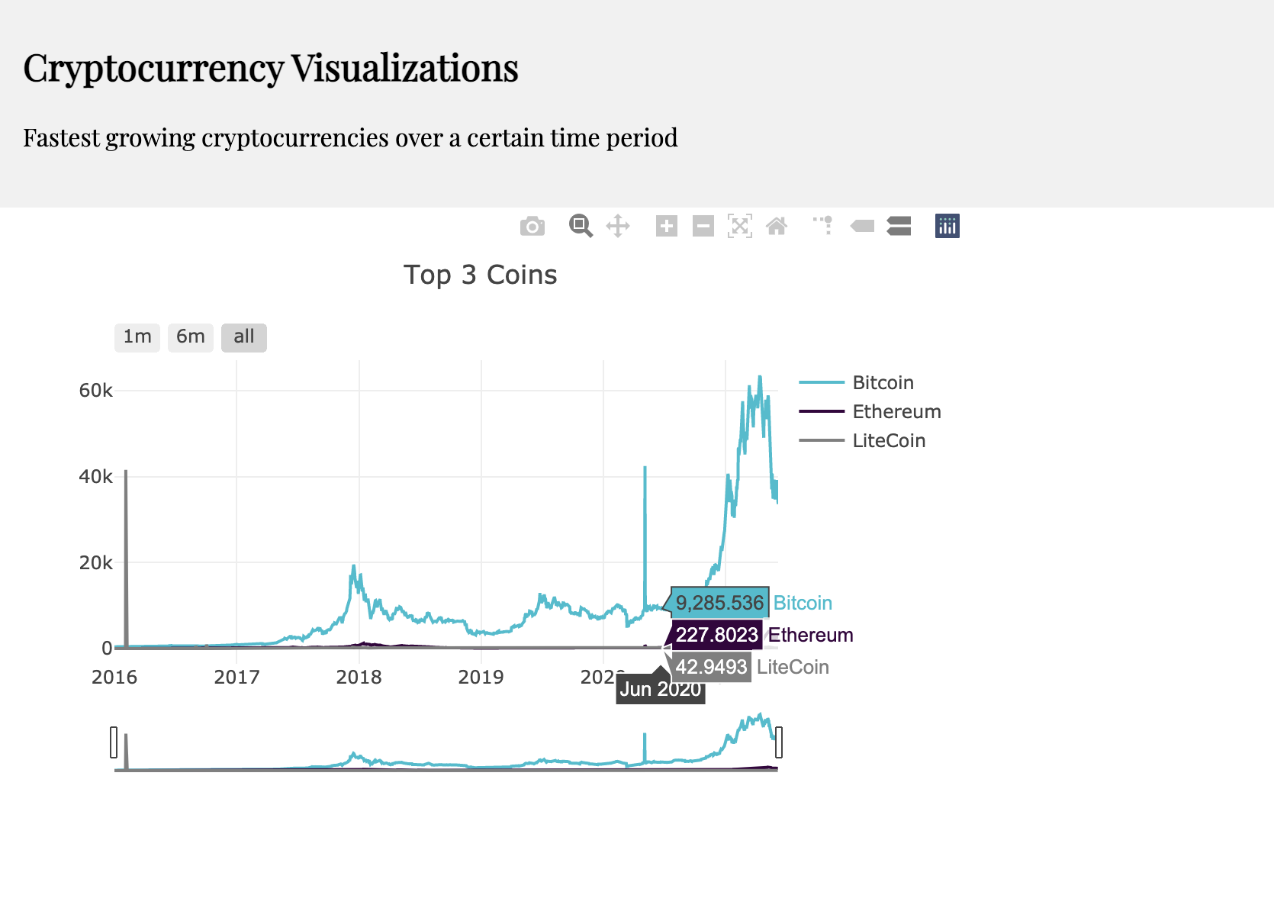
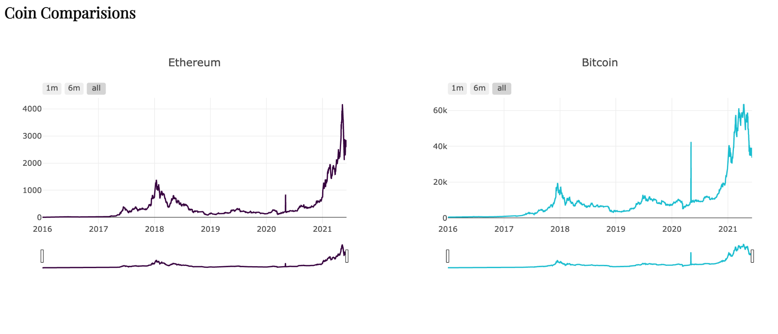
Conclusions

Slide 6

Thank you!

